Slide 1
DIP – Final Project BackLight Image Process
組員：柯劭函、游庭維、林宗翰、謝承佑

Slide 2
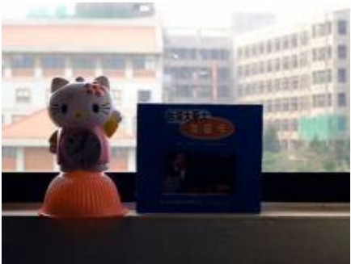
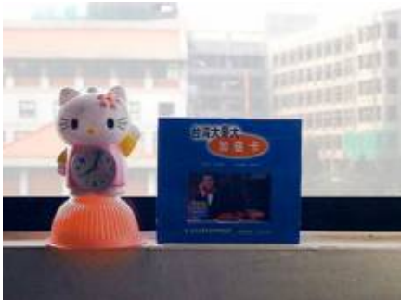


Problem？？

Slide 3
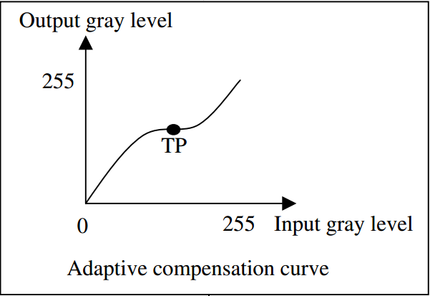
Basic Concept
Input Image
Detect
if backlight or not？
NO
Other Image Problem
Yes
Backlight with high degree
Compensated Image

Slide 4
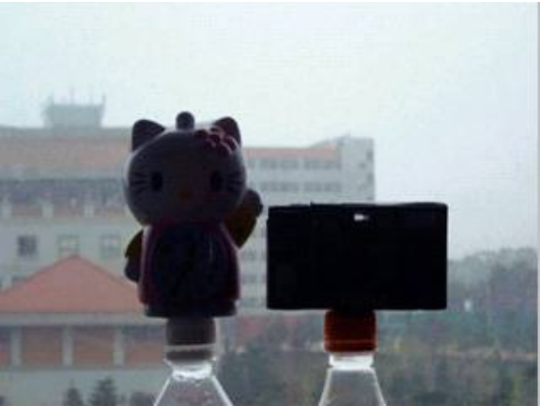
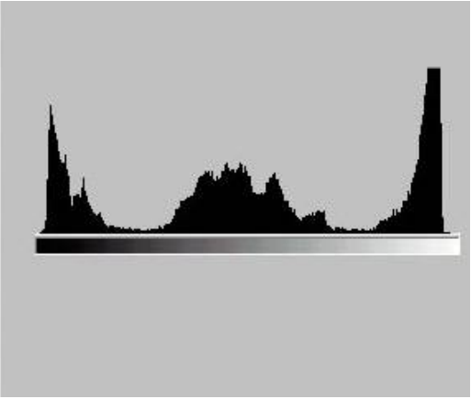
Detection Phase
透過image和histogram兩個方向，得出兩個backlight degree，最後利用fuzzy logic，歸納出最後的backlight degree。
Image
Histogram

Slide 5

It’s DEMO time！！！

